Slide 1
Breast Cancer Diagnosis by exploiting data exploration Techniques.

Slide 2
Team members:
1.Prathiksha Poojary-116A1059
2.Shruti Rao-116A1066
3.Jigar Somaiya-116A1033
Guided by:
Prof. Pranita Mahajan

Slide 3
Introduction
To create a model for improving accuracy of classification of malignant and benign tumor by exploiting the various techniques for data preprocessing
To compare the various preprocessing algorithms for various classification algorithms

Slide 4
Need of the topic:
1)Breast Cancer is the most common female cancer worldwide. All most 25% of all cancers with an estimated 1.67 million new cancer cases diagnosed in 2012.[14]
2)The life time risk of developing breast cancer in women is approximately 1/8 in USA, 1/ 12 in Europe, 1/40 in Asia [WHO 2008].
3)In a lot of cases, due to false-negative diagnosis,the tumor worsens or may lead to death.So to prevent this,there is a need for systems that can diagnose cancer with more accuracy[14]
4)Detection in early stages is important as the disease is curable if detected in early stages.

Slide 5
Literature Survey

Slide 6
Sr.no | TITLE OF THE PAPER | CONFERENCE/ YEAR | PURPOSE/ KEY FINDINGS | GAPS/ISSUES
1. | Comparison of different Machine Learning methods for Breast Cancer diagnosis By Ebru Bayrak,Tolga Ensari[1] Dataset-WBCD | EBBT,2019 | Comparison of SVM and ANN based on accuracy,Precision,recall,ROC Area. Finding: SVM gives better accuracy as compared to ANN.
2. | Breast Cancer detection using Machine Learning Algorithms By Shubham Sharma,Archit Agarwal & Tanupriya Choudhary[2] Dataset-WBCD | 2018 | Comparison between Random Forest,KNN,Naive Bayes. Findings: KNN gives the highest accuracy,followed by Random Forest. | Naive Bayes gives lowest accuracy due to comparatively smaller dataset size.
3. | Breast Cancer Classification using Machine Learning By Meriem Amrane,Saliha Oukid,Ikram Gagaoua,Tolga Ensari[3] Dataset-WBCD | 2018 | Comparison between Naive Bayes and KNN and evaluation of accuracy using cross validation. Finding: KNN Gives Highest accuracy | KNN gives less acuuracy when dataset is large due to increase in time complexity.

Slide 7
SR NO | TITLE OF THE PAPER | CONFERENCE/YEAR | PURPOSE/ KEY FINDINGS | GAPS/ ISSUES
4. | Using Machine Learning algorithms for breast cancer risk prediction and diagnosis - By Anusha Bharat , Pooja N and R Anishka Reddy[4] Dataset-WBCD | ICCCCC,2018 | Purpose- Compare different ML algorithms (Naive Bayes,KNN,SVM,CART etc.)for Cancer diagnosis. Findings- Best accuracy showed by KNN. SVM gives accurate results when input is standardized. | No preprocessing of data
5.. | Using Data Mining Tools for Breast Cancer Prediction and Analysis -By Dr S N Singh and Shivani Thakral[5] Dataset-WBCD | ICCCA, 2018 | Purpose- Use different data mining tools for breast cancer diagnosis.(Naive Bayes,CART) Findings- Naive bayes and simple CART work better than their alternatives. | Simple CART takes lot of execution time.
6. | Deep Learning Algorithms for Predicting Breast Cancer Based on Tumor Cells -By Panuwat Mekha and Nutnicha Teeyasuksaet[6] Dataset-WBCD | ICDAMT & ECTI, 2019 | Purpose-to diagnose breast cancer using deep learning methods.(tanh,maxout,rectifier activation functions.) Findings- deep learning methods work better than ML methods. | Different techniques gave different benefits.

Slide 8
Sr.no | TITLE OF THE PAPER | CONFERENCE/YEAR | PURPOSE/ KEY FINDINGS | GAPS/ISSUES
7. | Prediction of Breast Cancer using Support Vector Machine and K-Nearest Neighbour. -By Md.Milan Islam,Hasim Iqbal,Md.Rezwanal Haque,Kamrul Hassan.[7] Dataset-WBCD | IEEE HTC ,2017 . | Used SVM and KNN to predict breast cancer. Findings:SVM gives better performance in all parameters. | The false discovery rate is comparatively high in K-NN rather than SVM.
8.. | Breast Cancer Diagnosis Using Genetic Algorithm for Training Feed Forward Back Propagation. -By Prof.Dr. Hussein AttyaLafta,Noor KdhimAyoob,Asraa Abdullah Hussein.[8] Dataset-WBCD | NTICT'2017. | GA is used as a mechanism to get the ideal weights for FFBPNN. Findings:When GA was use,it gave better results than classic FFBPNN. | Preprocessing techniques have not been applied on algorithms without GA.
9. | Breast cancer diagnosis using GA feature selection and rotation forest -By Emina ALikovic & Abdulhamit Subasi[9] Dataset-WBCD | The Natural Computing Applications Forum,2015. | GA feature selection and different data mining techniques, namely Logistic Regression, Random Forest,Rotation forest etc. Findings: algorithms with GA were better.(Rotation forest gave the best accuracy) | Preprocessing techniques have not been applied on algorithms without GA.

Slide 9
SR.NO | TITLE OF THE PAPER | CONFERENCE/ YEAR | PURPOSE/ KEY FINDINGS | GAPS/ISSUES
10. | Breast Cancer Diagnosis Using Deep Learning Algorithm -by Naresh Khuriwal and Dr.Nidhi Mishra.[10] Dataset-Wisconsin Breast Cancer Dataset(WBCD) | ICACCCN / 2018 | Purpose-to diagnose breast cancer using CNN. Findings: CNN (with appr. Preprocessing techniques) gives very high accuracy. | Only used PCA model.
11. | On Breast Cancer Detection: An Application of Machine Learning Algorithms on the Wisconsin Diagnostic Dataset -by Abien Fred[11] Dataset-WBCD | ICMLSC /2018 Dataset-Wisconsin Breast Cancer Dataset | Purpose-to diagnose breast cancer using Machine Learning. Findings:SVM algorithm was used. | Inadequate preprocessing of the data.

Slide 10
Analysis Of The Literature Survey:
1.Different techniques can be used for classification.
2.It is observed that Preprocessing generally gives better results
3.Dimensionality reduction is needed.

Slide 11
Proposed System

Slide 12
Proposed System
To Preprocess data using:
1.Principal Component Analysis(PCA)
2.Linear Discriminant Analysis(LDA)
3.Normalization
4.Standardization

Slide 13
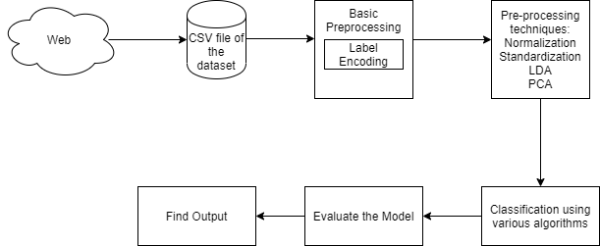
System Architecture
WBCD

Slide 14
Design and Methodology

Slide 15
Label Encoding
Label encoding refers to process of converting labels into numeric form to make it machine readable.
To convert this kind of categorical text data into model-understandable numerical data, we use the Label Encoder
Diagnosis | Diagnosis
Malignant | 0
Benign | 1

Slide 16
Normalisation
Need: To convert numeric values in a column to a common scale without distorting differences in the range of values.
We have used the minmax scalar.
Formula for min max scaler:
X-min/(max-min), where min is minimum value and max is maximum value in column

Slide 17
Standardization
Convert attributes with Gaussian distribution and with varying mean and standard deviation to standard Gaussian distribution with mean of 0 and standard deviation of 1.
we have used standard scalar
Formula for this is x-mean/standard deviation
Need: Useful for comparing data which would not be otherwise comparable.

Slide 18
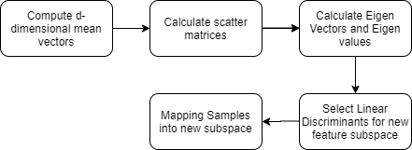
LDA

Slide 19
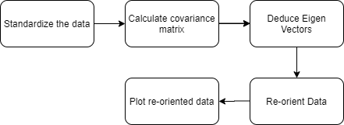
PCA

Slide 20
Applying classification algorithms
1. K-Nearest Neighbours (kNN)
2.Naive Bayes (NB)
3.Support Vector Machine (SVM)
4.Decision Tree (DT)
5.Random Forest (RF)
6.Logistic Regression (LR)
7.Multilayer Perceptron (MLP)
8.Stochastic Gradient Descent (SGD)
9. Adaboost

Slide 21
Results and Discussions

Slide 22
Implementation
Imported the wbcd dataset
Train-Test split: test size=0.2
Performed Label Encoding on it:
Malignant-0
Benign-1
Applied the various ML Algorithms with and without the different preprocessing algorithms
Compared the various computations to find out whether Preprocessing improves the accuracy

Slide 23
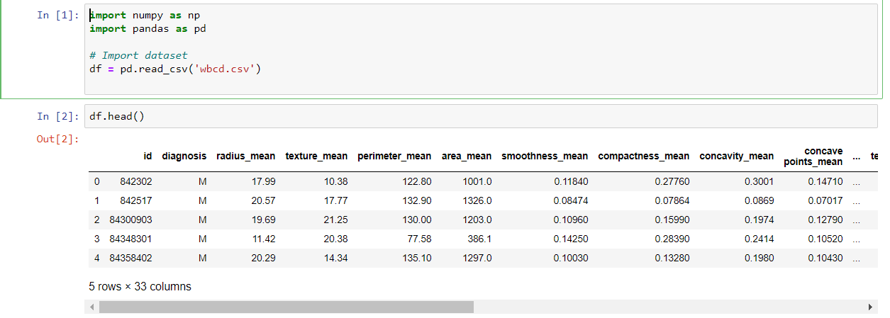
Importing dataset

Slide 24
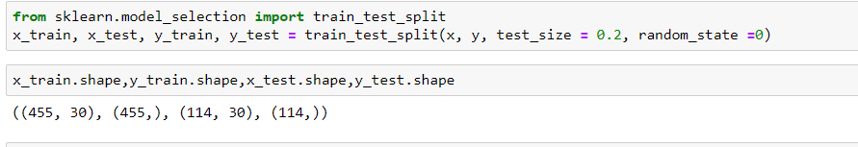
Train-test split

Slide 25
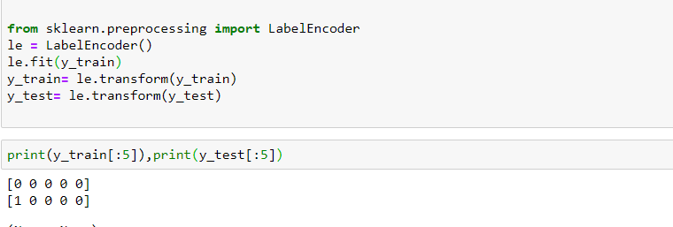
Label Encoding

Slide 26
Machine Learning Algorithms:
For each algorithm,we computed the results for the following:
Algorithm without any preprocessing
Algorithm with normalization of the data
Algorithm with standardization of the data
Algorithm with normalization and Standardization of data
Algorithm with PCA:
PCA (components-> 8,9,15)
PCA with normalization
PCA with standardization
PCA with normalization & standardization
6.Algorithm with LDA:
1)LDA
2)LDA with normalization
3)LDA with standardization
4)LDA with normalization and standardization

Slide 27
Measures for the analysis of output:
Accuracy:
ratio of correctly predicted observation to the total observations
Precision:
ratio of correctly predicted positive observations to the total predicted positive observations.
Recall:
ratio of correctly predicted positive observations to the all observations in actual class
F1-score:
F1 Score is the weighted average of Precision and Recall. Therefore, this score takes both false positives and false negatives into account.

Slide 28
Sr. no | Algorithm | Best Performing Pre-processing algo | Without Pre-processing
1. | Decision Tree | LDA PCA with norm & std Accuracy-95.6 Precision-96 Recall-96 F1 score-96 | Accuracy-91.2 Precision-91 Recall-92 F1 score-91
2. | Logistic Regression | LDA PCA with norm Accuracy-97.3 Precision-97 Recall-97 F1 score-97 | Accuracy-92.98 Precision-93 Recall-91 F1 score-92
3. | Multi-layer Perceptron | PCA with norm Accuracy-99.1 Precision-99 Recall-99 F1 score-99 | Accuracy-86.8 Precision-86 Recall-85 F1 score-85

Slide 29
Sr. no | Algorithm | Best Performing Pre-processing algo | Without Pre-processing
4. | Stochastic Gradient Descent | PCA with norm & std LDA Accuracy-96.49 Precision-97 Recall-97 F1 score-97 | Accuracy-71.92 Precision-83 Recall-72 F1 score-71
5. | Support Vector Machine | Standardization Accuracy-98.24 Precision-98 Recall-98 F1 score-98 | Accuracy-58.77 Precision-35 Recall-59 F1 score-44
6. | Random Forest | Standardization Normalization Accuracy-98.24 Precision-98 Recall-98 F1 score-98 | Accuracy-98.24 Precision-98 Recall-98 F1 score-98

Slide 30
Sr. no | Algorithm | Best Performing Pre-processing algo | Without Pre-processing
7. | Adaboost | Standardization PCA with norm and std Accuracy-97.37 Precision-97 Recall-97 F1 score-97 | Accuracy-95.6 Precision-96 Recall-95 F1 score-95
8. | KNN | LDA Accuracy-97.36 Precision-97 Recall-97 F1 score-97 | Accuracy-91.22 Precision-91 Recall-91 F1 score-91
9. | Naive Bayes | LDA Accuracy-96.49 Precision-97 Recall-96 F1 score-96 | Accuracy-92.98 Precision-93 Recall-93 F1 score-93

Slide 31
Conclusion and Future Scope

Slide 32
Conclusion
It has been observed that,most of the algorithms give better results with preprocessing rather than without.
All algorithms with the exception of Random Forest give better results.
For our dataset,Multi-Layer perceptron algorithm gives an accuracy of 99.1% when the data is normalized and PCA is applied on it.
Even Decision tree,which gives the least results after preprocessing,has an accuracy of 95.6% when the data is preprocessed with either LDA or PCA with normalization

Slide 33
Future Scope
We can further expand the research by including more Preprocessing algorithms
We can also test the preprocessing algorithms on more Machine Learning algorithms

Slide 34
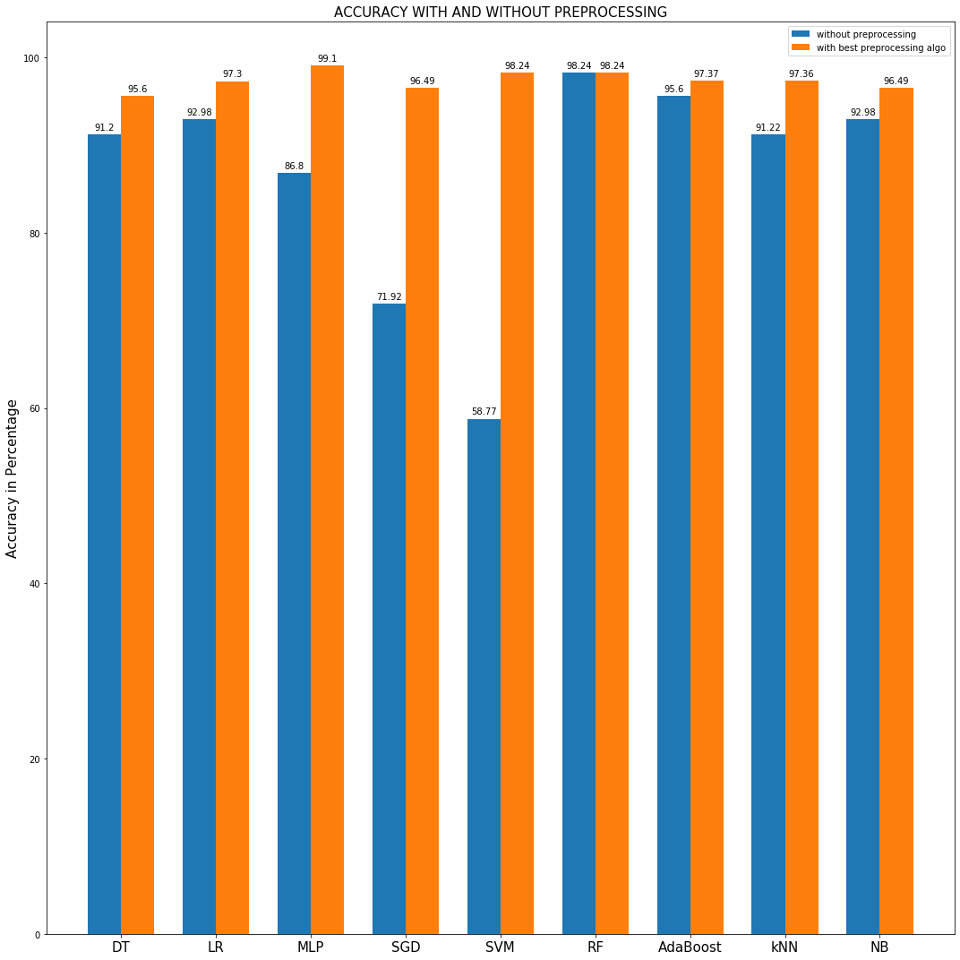
Accuracy with and without Preprocessing

Slide 35
References
[1]E. Bayrak, P. Kırcı and T. Ensari, ”Comparison of Machine LearningMethods for Breast Cancer Diagnosis - IEEE Conference Publication”, Iee-explore.ieee.org, 2019.
[2]S. Sharma, A. Aggarwal and T. Choudhury, ”Breast Cancer DetectionUsing Machine Learning Algorithms - IEEE Conference Publication”, Ieeex-plore.ieee.org, 2019.
[3]M. Amrane, S. Oukid, I. Gagaoua and T. Ensar ̇I, ”Breast cancer classifica-tion using machine learning,” 2018 Electric Electronics, Computer Science,Biomedical Engineerings’ Meeting (EBBT), Istanbul, 2018, pp. 1-4. doi:10.1109/EBBT.2018.8391453
[4]A. Bharat, N. Pooja and R. A. Reddy, ”Using Machine Learning algo-rithms for breast cancer risk prediction and diagnosis,”3rd International Con-ference on Circuits, Control, Communication and Computing (I4C), Banga-lore, India, 2018, pp. 1-4.doi: 10.1109/CIMCA.2018.8739696
[5]Singh, S. Thakral, Shivani, ”Using Data Mining Tools for Breast CancerPrediction and Analysis.”,2018,CCAA,1-4 10.1109/.2018.8777713.

Slide 36
[6]P. Mekha and N. Teeyasuksaet, ”Deep Learning Algorithms for Predict-ing Breast Cancer Based on Tumor Cells,” ,Joint International Conferenceon Digital Arts, Media and Technology with ECTI Northern Section Con-ference on Electrical, Electronics, Computer and Telecommunications En-gineering (ECTI DAMT-NCON), Nan, Thailand, 2019, pp. 343-346. doi:10.1109/ECTI-NCON.2019.8692297
[7]M. M. Islam, H. Iqbal, M. R. Haque and M. K. Hasan, ”Prediction ofbreast cancer using support vector machine and K-Nearest neighbors,”,2017IEEE Region 10 Humanitarian Technology Conference (R10-HTC), Dhaka,2017, pp. 226-229.
[8]H. AttyaLafta, N. KdhimAyoob and A. A. Hussein, ”Breast cancer diag-nosis using genetic algorithm for training feed forward back propagation,”2017 Annual Conference on New Trends in Information CommunicationsTechnology Applications (NTICT), Baghdad, 2017, pp. 144-149.16
[9]Alickovic, Emina Subasi, Abdulhamit.”Breast cancer diagnosis using GAfeature selection and Rotation Fores”, Neural Computing and Applications,2015.10.1007/s00521-015-2103-9.
[10]Khuriwal, N. and Mishra, N.,”Breast Cancer Diagnosis Using Deep Learn-ing Algorithm” - IEEE Conference Publication,2019.

Slide 37
[11]Agarap, Abien Fred,” On Breast Cancer Detection: An Application ofMachine Learning Algorithms on the Wisconsin Diagnostic Dataset”. Inter-national Conference on Machine Learning and Soft Computing (ICMLSC)2018, At Phu Quoc Island, Viet Nam 10.1145/3184066.3184080.
[12]Wolberg, W.H., Mangasarian, O.L. ”Multisurface method of patternseparation for medical diagnosis applied to breast cytology.”, In Proceedingsof the National Academy of Sciences,1990, 87, 9193–9196.
[13]Zhang, J.”Selecting typical instances in instance-based learning.”, In Pro-ceedings of the Ninth International Machine Learning Conference ,1992,(pp.470–479).
[14]”Breast cancer”, World Health Organization, 2019.[15]”WHO — WHO position paper on mammography screening”, Who.int,2019.
[16]”Breast cancer - Diagnosis and treatment - Mayo Clinic”, Mayoclinic.org,2019.
[17]Dua, D. and Graff, C.,UCI Machine Learning Repository, Irvine, CA:University of California, School of Information and Computer Science

Slide 38
THANKYOU

